Slide 1



Cooperative Housing Finance
Platform
Presented by Samuel Oladipo
Tech Media Manager, NISH Affordable Housing Ltd
November 18, 2025

Slide 2




What is Proppay?
Proppay is a digital cooperative housing finance platform developed by NISH Affordable Ltd in collaboration with financial institutions and fintechs
Platform
Aggregation
Insurance
Digital cooperative housing finance for inclusive solutions.
Combines savings for efficient loans and repayments.
Offers protection for homeowners and their investments.
BUY PROPERTIES | RENT-TO-OWN PROPERTIES | EQUITY SAVINGS | LOANS/MORTGAGES | PAYMENTS | INVESTMENTS | OFFPLAN ESCROW | PROPERTY INSURANCE
2

Slide 3



Proppay Value Proposition Overview
Rates
Affordability
Trust
Competitive interest rates ensure affordability for homeowners.
Flexible terms up to 20 years for mortgage options.
Verified developers ensure quality homes for buyers.
3

Slide 4



Proppay Value Proposition Explained
Developers
Ownership
Payments
Verified developers ensure quality and reliability in projects.
Equity savings programs support affordable homeownership options.
Integrated services streamline transactions for peace of mind.
4

Slide 5

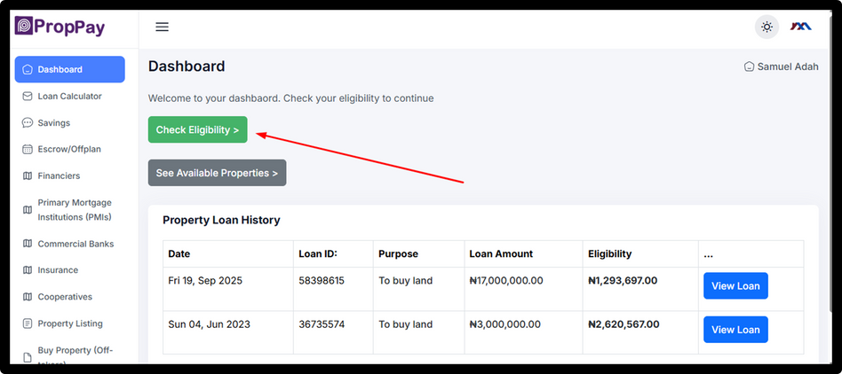

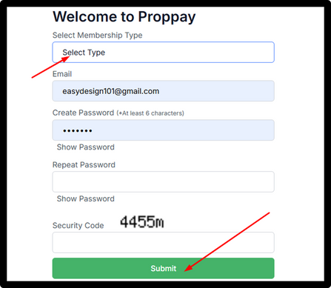
How Proppay Works
Create Account
Registration Type
Check Eligibility
Visit PROPPAY.COOP and easily set up your account.
Choose your registration type to proceed with sign-up.
Assess your loan eligibility with a quick online check.
Complete Profile
Apply for Financing
Fill out your profile and provide all necessary details.
Submit your application and discover verified property options.
5

Slide 6

website
Join Proppay Today
www.proppay.coop
Phone
+234 701 630 5349
App stores

